Slide 1

Supply and Demand Trends in the Turkish Feed Industry
ILKNUR IGDIR
HAKAN AGRO DMCC
FEED DESK MANAGER
ilknur.igdir@hakanfoods.com

Slide 2

7
1
8
2
3
3
5
0
5
6
What is the meaning of these numbers ?

Slide 3
9
0
7
0
0
0
0
0
0
0
By 2050 it is estimated that the earth's human population will be 9.07 billion.

Slide 4
2
0
0
0
0
0
0
0
0
0
Do we really have a plan to feed 2 billion more people or really the World ready to feed 9 billion people.

Slide 5
Supply and Demand Trends 2050
World population is expected to increase by 34% to reach 9.1 billionBy 2050, with the 2.3 billion increment to take place entirely in developing countries.
And it will occur wholly in urban areas which will swell by %86 while rural populations shrink by %18.
In the face of this, natural resources, namely land and water will become more and more scarce because of increasing pressures. This means that a smaller rural workforce will have to produce more and better from fewer resources to meet future demand.
In addition to the growing resources scarcity, global agriculture will have to cope with the effects of climate change.
Also agricultural commodities will become increasingly important for biofuel production as well as for other industrial purposes.

Slide 6
World Grain Consumption
Billion Tonnes
45%
60%
Source: FAO

Slide 7
Supply and Demand Trends in 2050
Agriculture will have no choice but to be more productive.
Future production increases would mostly come from yield growth and improved
Cropping intensity rather than from bringing more land into cultivation. And this will require substantial increases in the sector. More irrigation systems, machinery,more roads, better rural infrastructures, skilled and better trained farmers.
Agricultural growth is key to expansion of the entire economy. Emprical evidence shows that GDP growth originating in agriculture is at least twice as effective in combating poverty as GDP growth originating in ather sectors of economy.

Slide 8
+ %3 average per year

Slide 9
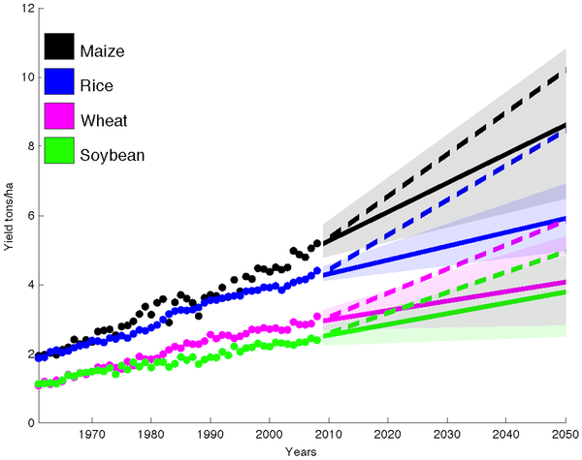
It’s Not Enough…
As you can see, yields have been growing fairly constantly in all four areas. The solid lines show what would happen if this growth continued. And it's not enough.
The dashed lines above show how productivity would need to grow even more rapidly for the world to satisfy expected demand and double global food production by 2050 in a sustainable manner, without razing more forests for farmland. "Current rates," the authors note, "are not achieving this goal."

Slide 10
Conclusion:
Continued population growth and GDP → increased purchasing power.
Meat, egg and milk consumption to increase: + 3%/yr
Compound feed production to increase +3 %/yr

Slide 11
Conclusion:
4. Grain + Soy production for feed projected to increase + 2.5 %/yr
5. Projected deficit in grain and soy production: 0.5 %/yr or approx. 30 Million mt by 2030.
6. “Stocks : Use” ratio decreasing by approx. 1 %/yr.
  How to assure feed and food security
and covering the (supply – demand) gap?

Slide 12
+ 17 million
(%22,2)
Turkish Population Forcast

Slide 13
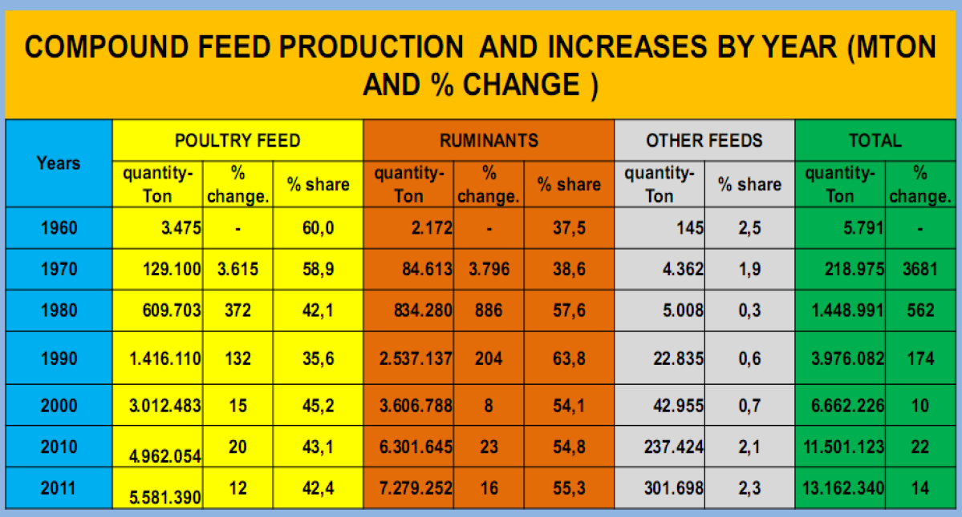

Slide 14
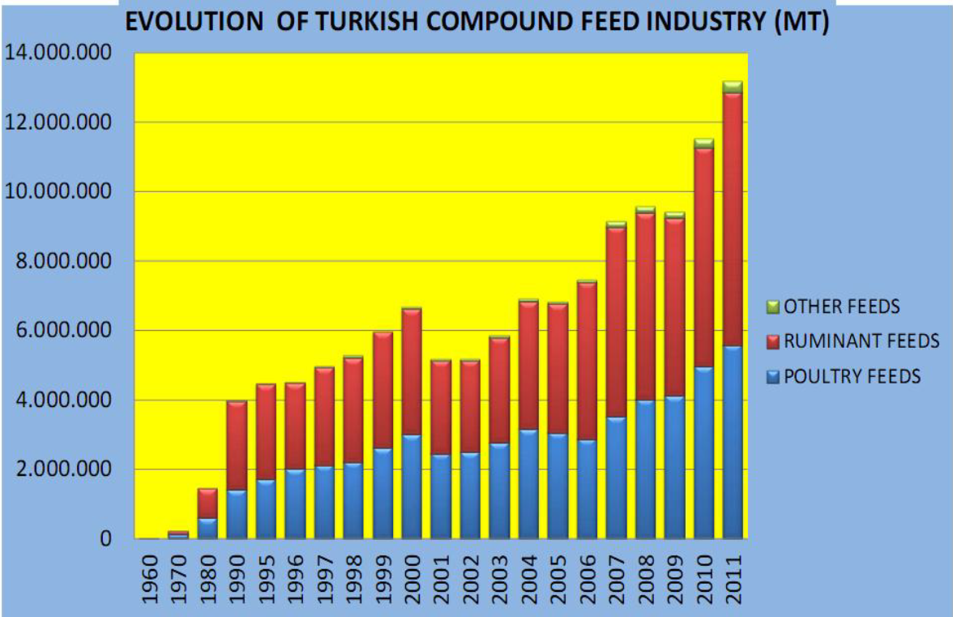

Slide 15
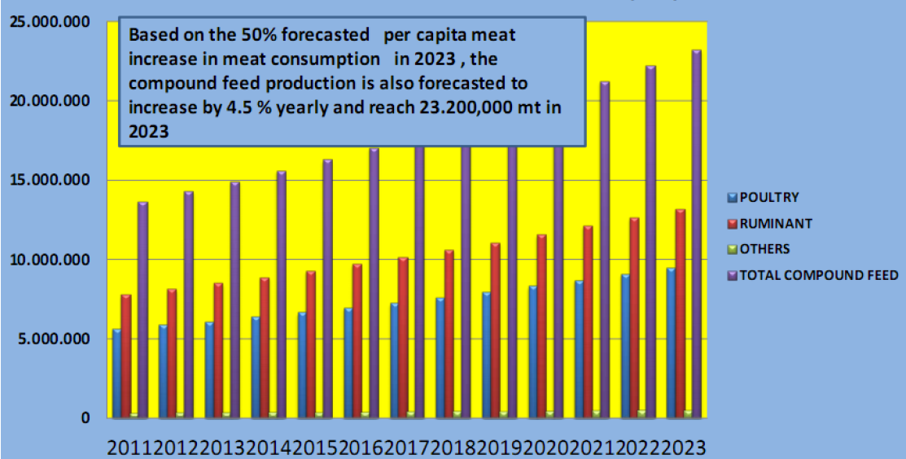
Turkey feed production forcast

Slide 16
Turkish Feed Import

Slide 17
More meat demands means more feed demand.
“Turkish Population and GDP growth driving meat consumption. More meat means more feed demand and animal feed supplements are rising.
Health and food safety concerns are putting pressure on better quality feed ingredients. There is growing concern with enviromental issues in animal agriculture. Especially by 2009 Turkey Biosafety regulations ,GMO issue is a major topic for all exporters , importers and feed plants.

Slide 18
So what can the world actually do?
What are developing trends in the use of ingredients for the production of animal feed?
How will changes in the availability of key ingredients affect formulations and the cost of feeding animals over the next three years?
What new technologies and managerial approaches are being harnessed to increase feed efficiencies and lower costs per unit of production of animal protein?
What new technologies and approaches to formulating feed are likely to be introduced into the market over the next three years

Slide 19
Let’s stop wasting by-products
By-products of food and bioethanol industries become more important everyday in Turkish compound feed industry.
Turkish nutritionists and feed plants try to learn more about animal feeding with more by-products insead of grains and soybeans.
This new trend let us more consantrate «how to re-gain waste of food industry in to animal feed» of course drying ,granulating is needed most of the time for extend the shelf life and for economic transport of by products such as sbpp ,ddgs, citrus pulps etc.

Slide 20
Let’s stop wasting World limited resources!
And food industry should be more consantrated on their by products quality spects and their economic value.
Also we should more consantrate on animal nutrition.
Researches on Animal nutritional needs and its effects on human health become more important for not waste world limited resources.

Slide 21
THANK YOU

